Slide 1
INNER AND LEFT JOINS

Slide 2
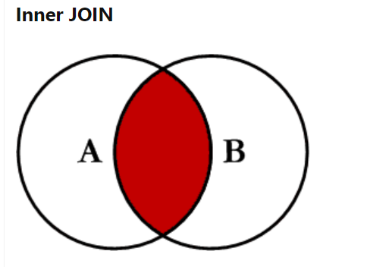
ONLY PICKS UP COMMON VALUES, NUMBER OF ROWS DEPENDS ON HOW MANY VALUES GOT MATCHED JOINED.

Slide 3
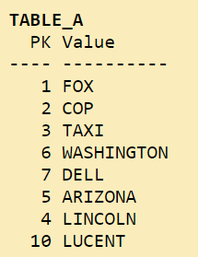
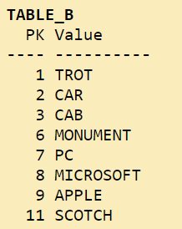

Slide 4
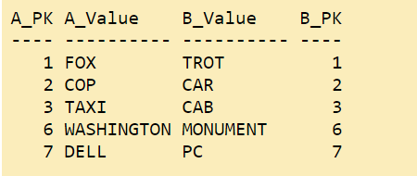

Slide 5
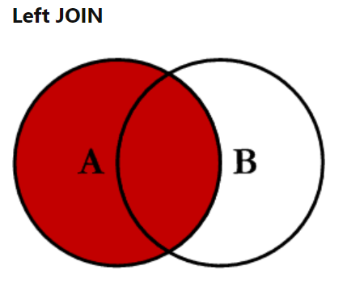
Will return all of the records in the left table (table A) regardless if any of those records have a match in the right table (table B). It will also return any matching records from the right table.

Slide 6
